Slide 1
Course title and date of event
BA Football Development and Coaching
June 2021 Virtual Open Day

Slide 2
Welcome. We will be covering…
Is this course for you?
Why study at Plymouth Marjon University?
Our course offer/teaching/assessment style
Accreditation/opportunities/outcomes
How teaching has worked this year/might work next year
What our students say about us
Life as a student and any questions

Slide 3
Marjon statistics slide 1

Slide 4
Marjon statistics slide 2

Slide 5
National Student Survey
Satisfaction in the National Student Survey 2020, including:
Staff are good at explaining things: 94%
My course has provided me with opportunities to apply what I have learnt: 94%
98%

Slide 6
The Football industry is an exciting and dynamic industry that requires knowledge and appreciation of:
Coaching
Education
Pathways: grassroots to elite
Management / Leadership / Business
Wider society
Inclusion
Hands-on experience
Event Management
Talent I.D
Development of projects/
initiatives

Slide 7
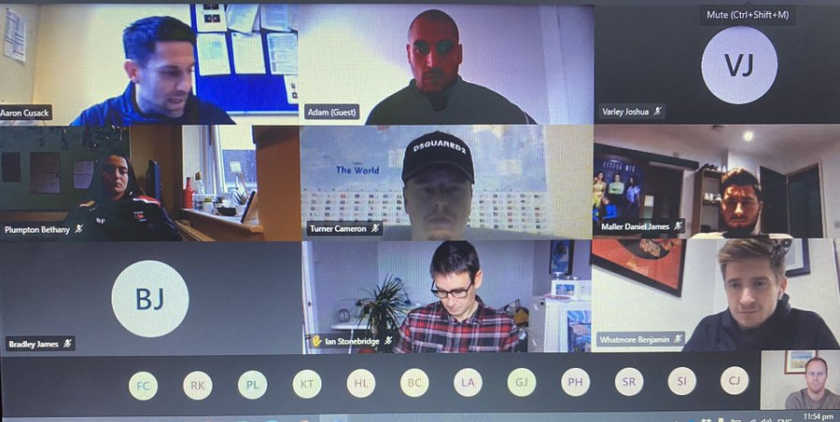
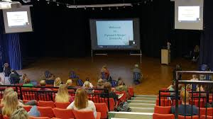
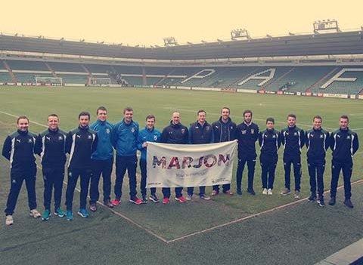
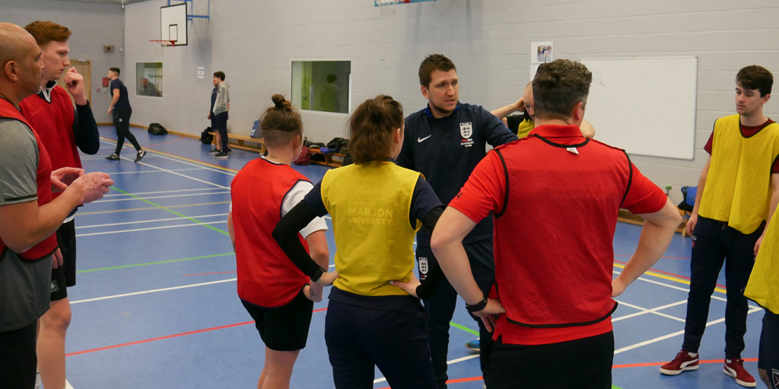
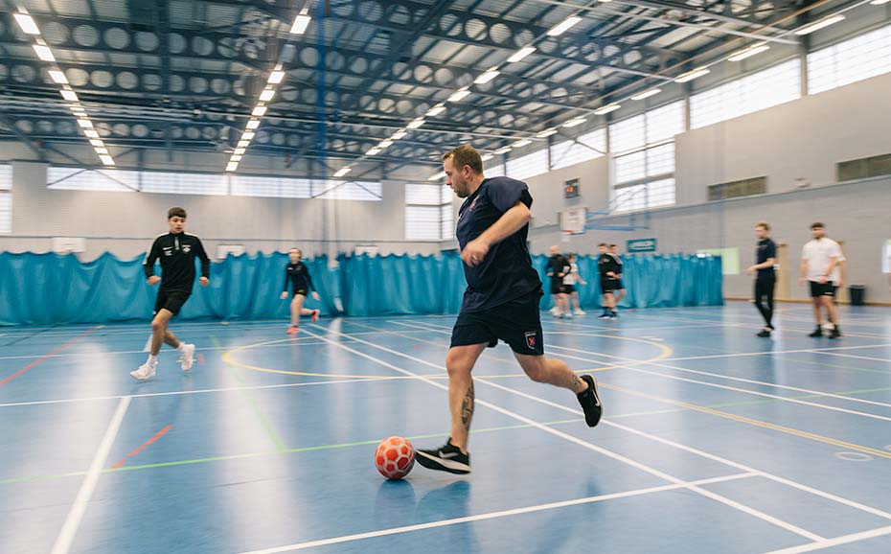
How will we teach you?

Slide 8
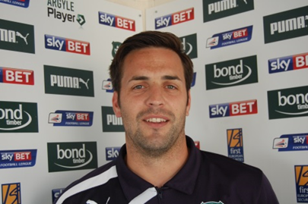
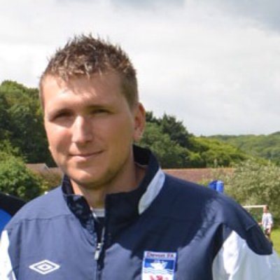
Working in partnership…
"We’re delighted to support students through placements, guest lectures and events in this rare opportunity to be involved at the heart of professional organisations such as ours, which significantly improves their CV’s and career prospects.”
(Chris French, DCFA County Development Manager)
“Almost half our workforce have completed courses in football and coaching at Marjon which is proof a degree leads to a great job”.
(Mark Lovell, Plymouth Argyle Community Trust Manager)

Slide 9
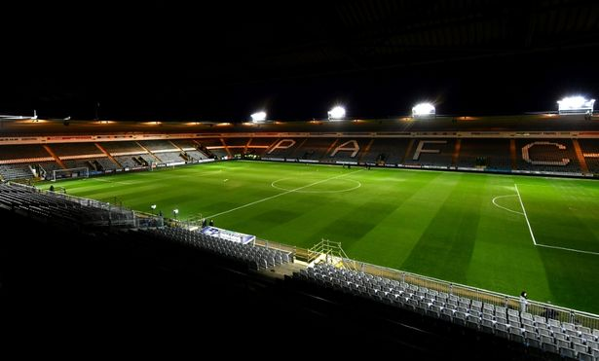
Academic underpinning
Personalised support
Applied industry experience
Core themes:
Delivered by specialist subject academic across the School of Sport Health and Wellbeing and industry practitioners, specifically from Argyle Community Trust and Devon FA.

Slide 10
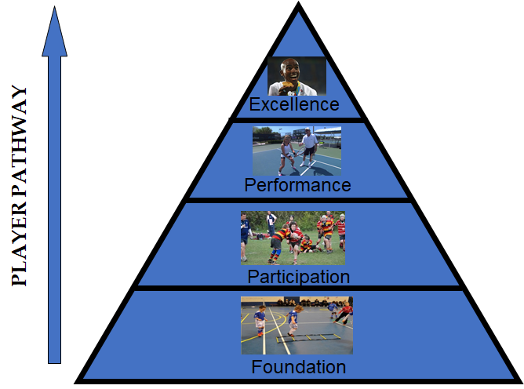
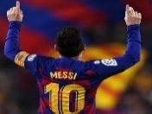
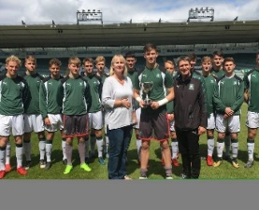
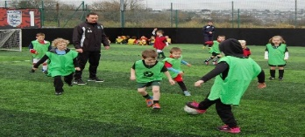
Football Development Pathway/ Long Term Player Development

Slide 11
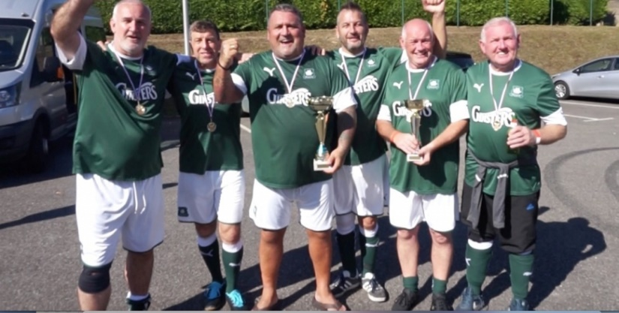
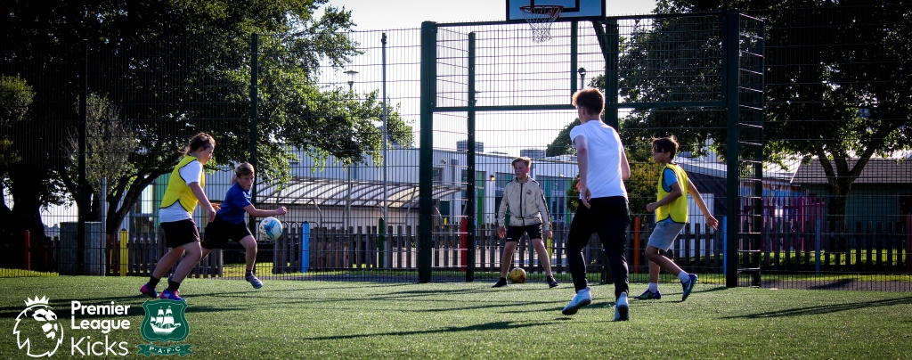
Or… Using sports (football’s) power for other benefits!
Developing people, facilities, organisations
Opportunities for all (inclusion)
Wider societal issues
Physical wellbeing
Mental well-being
Social inclusion
Diversionary activity (Youth Work) Drugs / Alcohol
Estate-based interventions.
Training, Skills and Employment interventions.

Slide 12
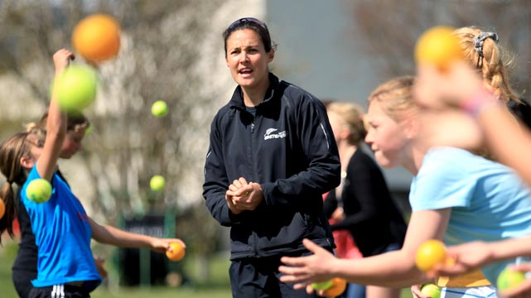
Football Development Practitioner
Understanding people
A facilitator/activator
Bring people together
Appreciate the ‘bigger picture’
Knowledge of UK sporting landscape
Often, the person behind the people…….
Coach – hands on pitch

Slide 13
Camp America?
OPPORTUNITY TO SPEND 9 WEEKS LIVING AND WORKING ON A SUMMER CAMP IN THE USA!

Slide 14
Second year – study abroad option

Slide 15
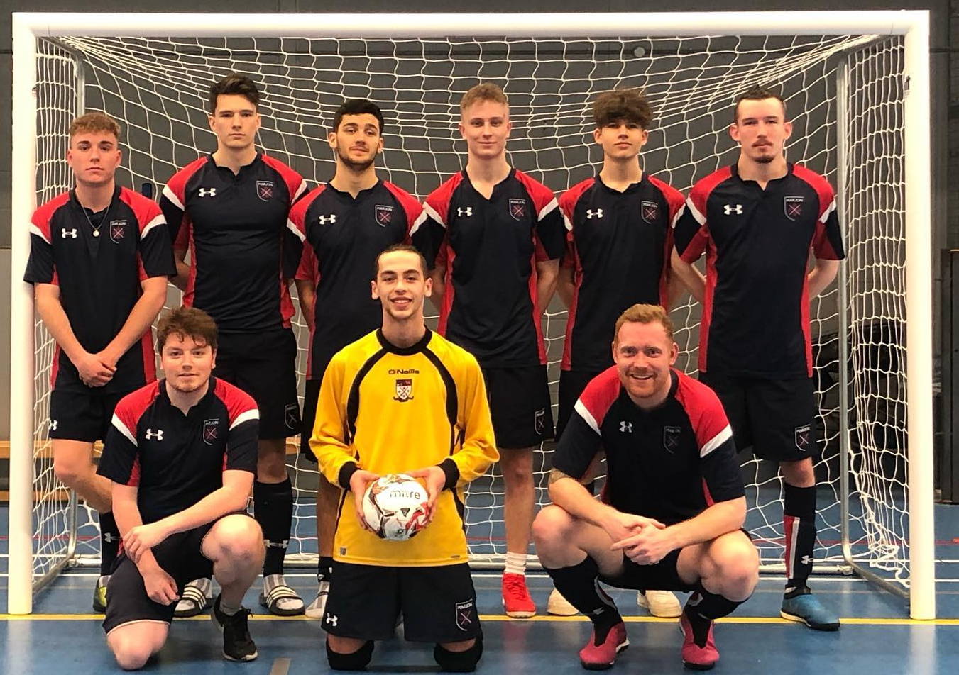
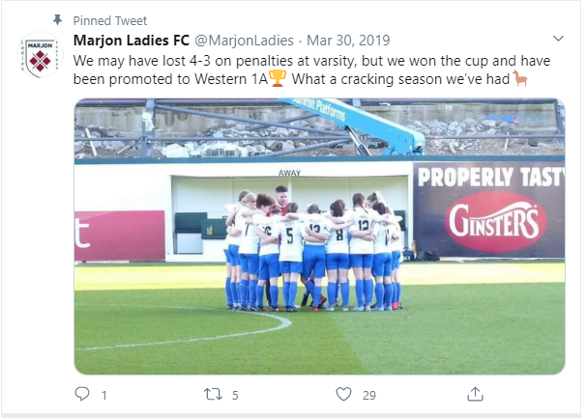
Full playing and
Coaching Programme for Futsal and Football
BUCS, local league, and Varsity
Represent Marjon University in British University and Colleges Sport BUCS) competitions (Wednesday fixures).
Take part in the annual Varsity competition against Plymouth University.

Slide 16
Extra Qualifications / Awards: FDV
Graduate Employability –
Coach Education
FA Level 1, 2
FA Level 3 (UEFA B)
FA Futsal L1, L2
FA Coaching Disabled Footballers
A flexible approach to YOUR needs
Partnerships with football providers for your education, and subsequent development

Slide 17
Graduate Employability
Employers support students applying knowledge, experience and skills.
Students apply for ‘case-study’ graduate roles through the module through letters, CVs, presentation and job interviews.
These have led to ‘real-world’ job offers in all of these companies.

Slide 18
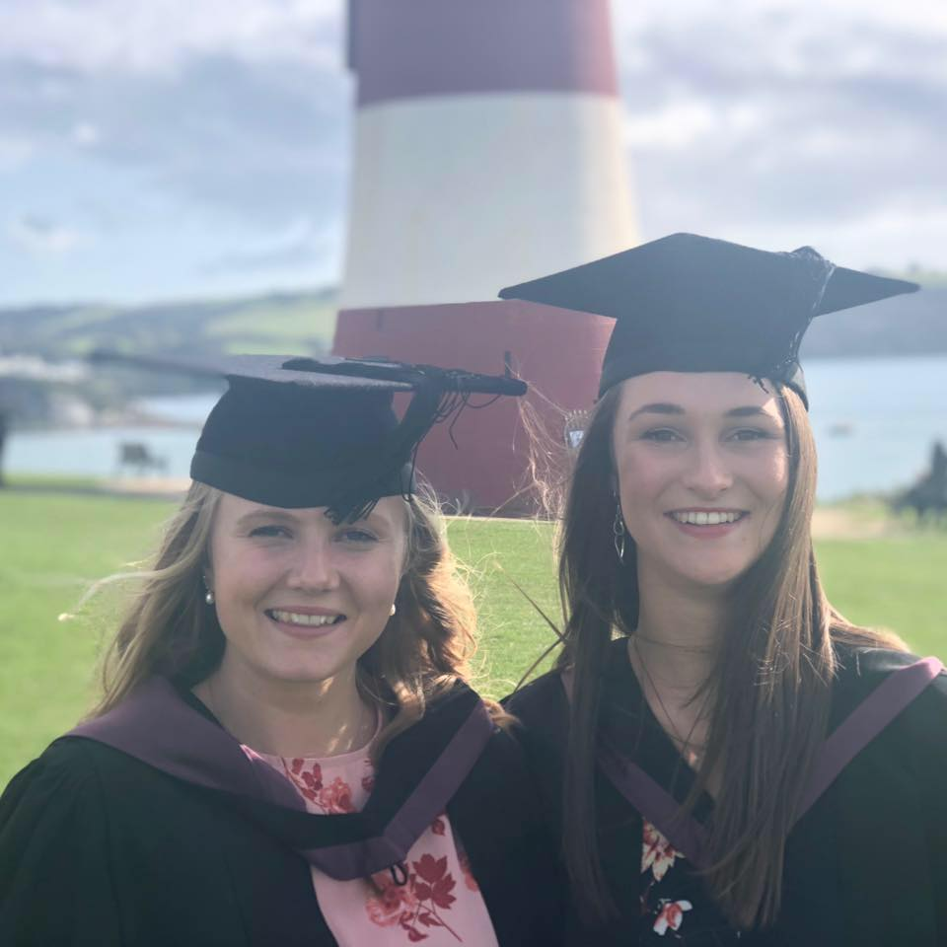
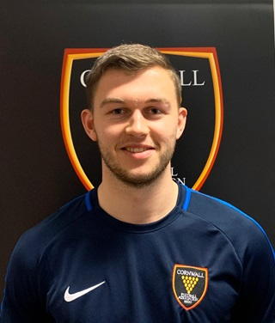
Recent success stories…
Alice Young – Mayflower 400 events officer
George Roberts: CFA Junior Football Development Officer

Slide 19
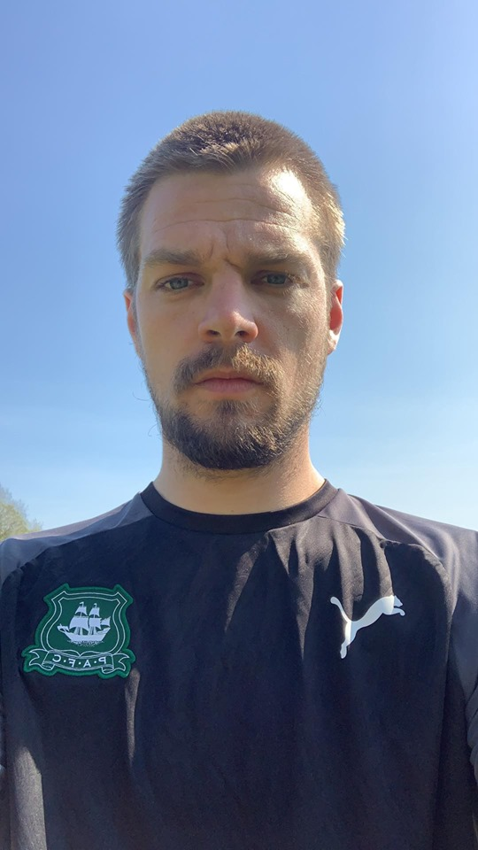
Recent success stories…
Ryan Perks – Women and Girls Officer
Mark Blackwell, Schools and Community Coach

Slide 20
Careers
Who do you know who already works in football?
What do they do?
Research the jobs and viable roles
Who might employ you?
Careers
International coaching
Sport Management
Prof Football Clubs
Pro Club Comm. Depts.
Sport/
Football Dev. Officer
NGB’s
Masters Degree
Teaching
Football Academies
Postgraduate Research / Lecturer
County Sports Partnership
Soccer Schools

Slide 22
A great university community
Online
Face to face

Slide 23
Keep in touch…
Name Dr Phil Brown
Senior Lecturer and Programme Leader
Course name BA Football Development and Coaching
Plymouth Marjon University
pbrown@marjon.ac.uk
Happy to have an informal chat over the phone
Dwain Morgan dwain.morgan@pafc.co.uk
@MarjonSPDEV
@MarjonFootball

