Slide 1
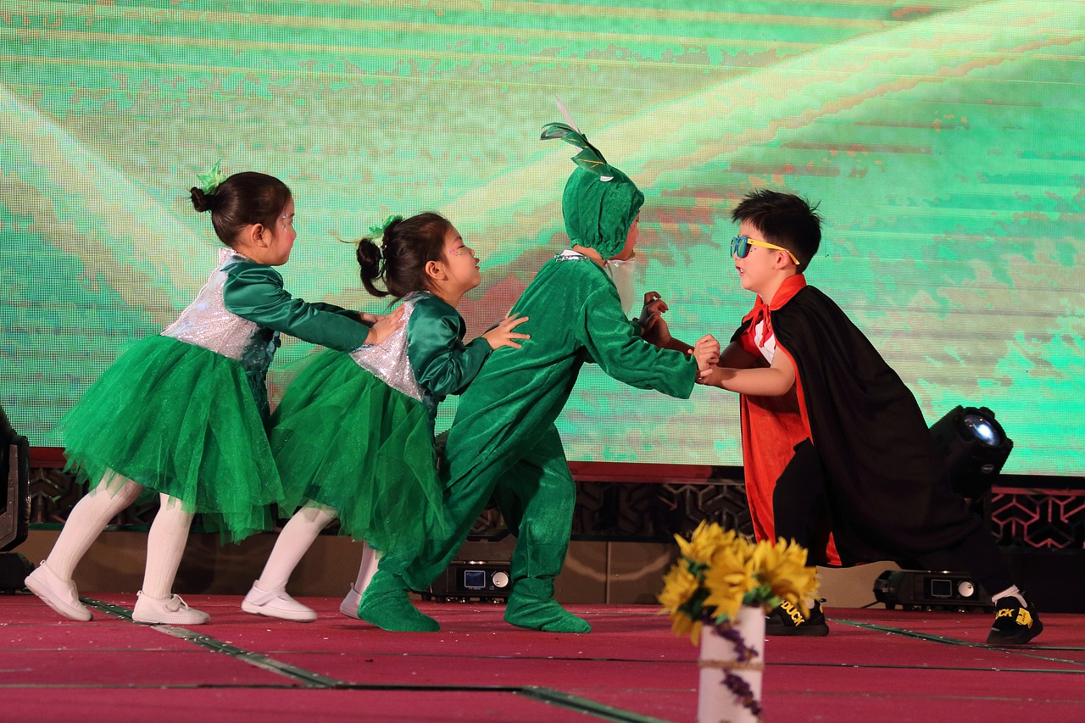
BA (Hons) Physical Education Welcome to Marjon
Erica Eaton Quinn
2023-2024

Slide 2
Welcome to Marjon…
This is the start of an amazing journey…
Where you will make many new friends…
And you will develop both professionally and personally…

Slide 3
That will help you to realise your potential… …and become an ‘outstanding’ PE Teacher
Meet the Teaching Team that will help you to realise your potential

Slide 4
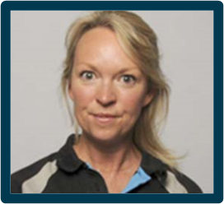
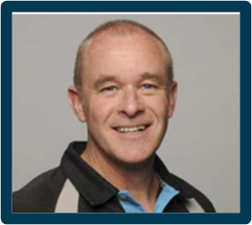
Sport Coaching, PE and Dance…
Erica Eaton Quinn
PL – Physical Education and BA (Hons) Physical Education with Dance
Meet the Team!
Kelvin Kirk
PL – Sport Coaching and PE

Slide 5
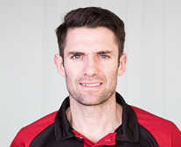
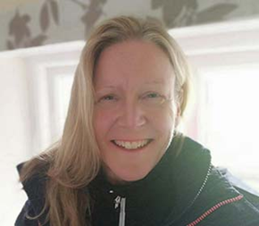
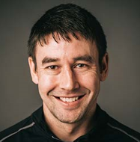
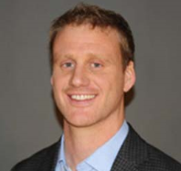
Sport Coaching and Physical Education Teaching Team
Aaron Cusack
Kelvin Kirk
Erica Eaton
Ian Stonebridge
Kass Gibson
Juliet Paterson

Slide 6
Communication…
…very important between staff and students…

Slide 7
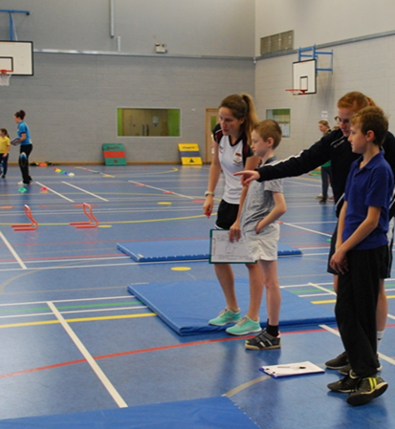
We are lucky to be a small university…
We get to know our students really, well really quickly!
We can help you to develop your strengths further and work to fill any gaps
We have an open-door policy which means that you can normally make contact with staff quickly if you have any concerns

Slide 8
Open Door Policy…
If we are in our office and you want to chat just knock!
If we are not in our office, the best way to contact staff is through Email.
We try to respond to you within 3 days.
Staff will also contact you through your Uni email.
Make sure that you regularly check your inbox.
Have you all received your Uni Email?

Slide 9
Personal Development Tutor
PDTs have 3 main responsibilities:
A pastoral role: to be your first point of contact to discuss any issues that might impact on your studies.
They can refer you to additional support as required.
An academic support role: to be someone that you can discuss academic progress and any problems, doubts or anxieties about your degree programme.
A professional guidance role: to be someone who can discuss and support you in planning for graduate employment and/or further study.

Slide 10
Do make the most of all the learning opportunities available to you, so…
However,
If you are ill genuinely please do not attend.
If you are not genuinely ill, please do not say you are.
Make every attempt to attend all taught sessions.
Please be responsible for your learning:
Autonomy
Ownership
Empowerment

Slide 11
So…
What do we expect of you?

Slide 12
Teaching and Coaching
Professionalism at all times
Notes:
Do we all agree that these future careers require us to be fully professional at all times?
What demonstrates professionalism?

Slide 13
Teaching and Coaching
Be respectful
Be prepared
Be punctual
Be sensible
Be safe!
Be professional!
Notes:
Do we all agree that these future careers require us to be fully professional at all times?
What demonstrates professionalism?

Slide 14
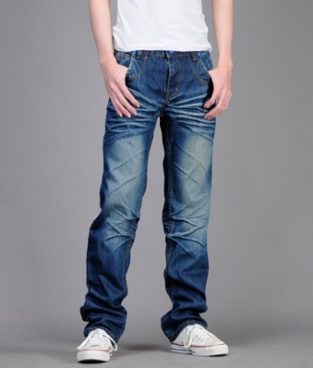
Professional Appearance
Lectures and Seminars: Fairly standard dress is acceptable unless the session is delivered in a practical environment.
Practical Sessions: Marjon Kit!

Slide 15
You will need…
A Marjon Branded Polo Shirt or Technical Tee (remember you need to wash these!)
These can be ordered through the Kukri link
Marjon Branded Outer Top, choose from:
Contact Jacket
Sweat Shirt
¼ Zip Top
Hoodie
Waterproof jacket
Marjon Branded tracksuit trousers/bottoms or plain navy blue other brand.

Slide 16
What will I study in Year 1?
Semester A |  | Semester B
PHSC03 Becoming a PE Teacher or a Sports Coach | PHSC01 Fundamental Movement Skills (FMS) | PHSC04 Sports Science Principles of Growth & Development
 | PHSC02 PE and the Importance of Lifelong Engagement | SCPC03 International Studies in Sport and Physical Education
 | SCPC01 Sport Coaching and the Coaching Process

Slide 17
Let’s focus on…
Semester A
What will you study?

Slide 18
Becoming a sports coach or PE teacher.
This is an immersive module
You will study this module alone for the first 4 weeks.
We will help you to develop the academic skills that you need for success at university.
We will introduce you to some of the concepts underpinning teaching and coaching.
You will have the opportunity to meet your fellow students and make lasting connections.

Slide 19
Understanding Fundamental Movement Skills (FMS)
After Reading Week you will start a module focused on understanding FMS
FMS underpin all sports and indeed all physical activities.
As a PE teacher or sport coach you must understand FMS and skills acquisition.
You will also explore the biomechanics that enables you to deliver FMS and a range of underpinning skills.

Slide 20
NCPE, Health and Life-long Participation
You will study a module focused on the location of PE within the national curriculum.
You will consider whether PE can have an impact on the health of our next generation.
You will explore how we can encourage our pupils to engage with life-long participation.

Slide 21
Ok, if you are really keen to get started…
And you want to stay ahead of the game!
Have a look at the following 2 Introductory Tasks!

Slide 22
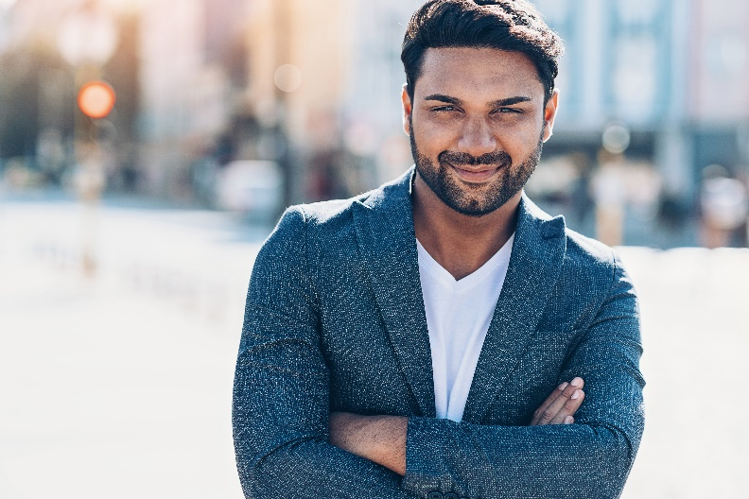
Task 1: Your CV
Locate your current CV
Update it based on your experiences over the last academic year and as you go through the Summer
You will be working on your CV in the first module you study to make you really stand out from the crowd!
Once it is set up well, you just need to keep adding your expanding knowledge, skills and understanding to it.
You can also keep adding in any short courses and qualifications you gain.

Slide 23
Task 2: Consider…
“What skills and knowledge does an ‘outstanding’ PE teacher need?”

Slide 24
So, welcome to
If you have any questions or concerns related to the BA (Hons) Physical Education or the BA (Hons) Physical Education with Dance degree programmes, please email me at eeaton@marjon.ac.uk

