Slide 2
equals
You will not get a grade for your formative essay, but you can expect in your written feedback:
an indication of the rough grade band level that you are attaining
suggestions on what you can do to improve your work
an idea of what you are doing right.

Slide 3
Formative Assignment (500 words) – due in on Turnitin on
THURSDAY 14th September 2023
The Special Educational Needs and/or Disabilities Code of Practice
(2015) stresses the importance of promoting high-quality inclusive
teaching in classrooms. Discuss the importance of inclusive practice
within the primary classroom.

Slide 4
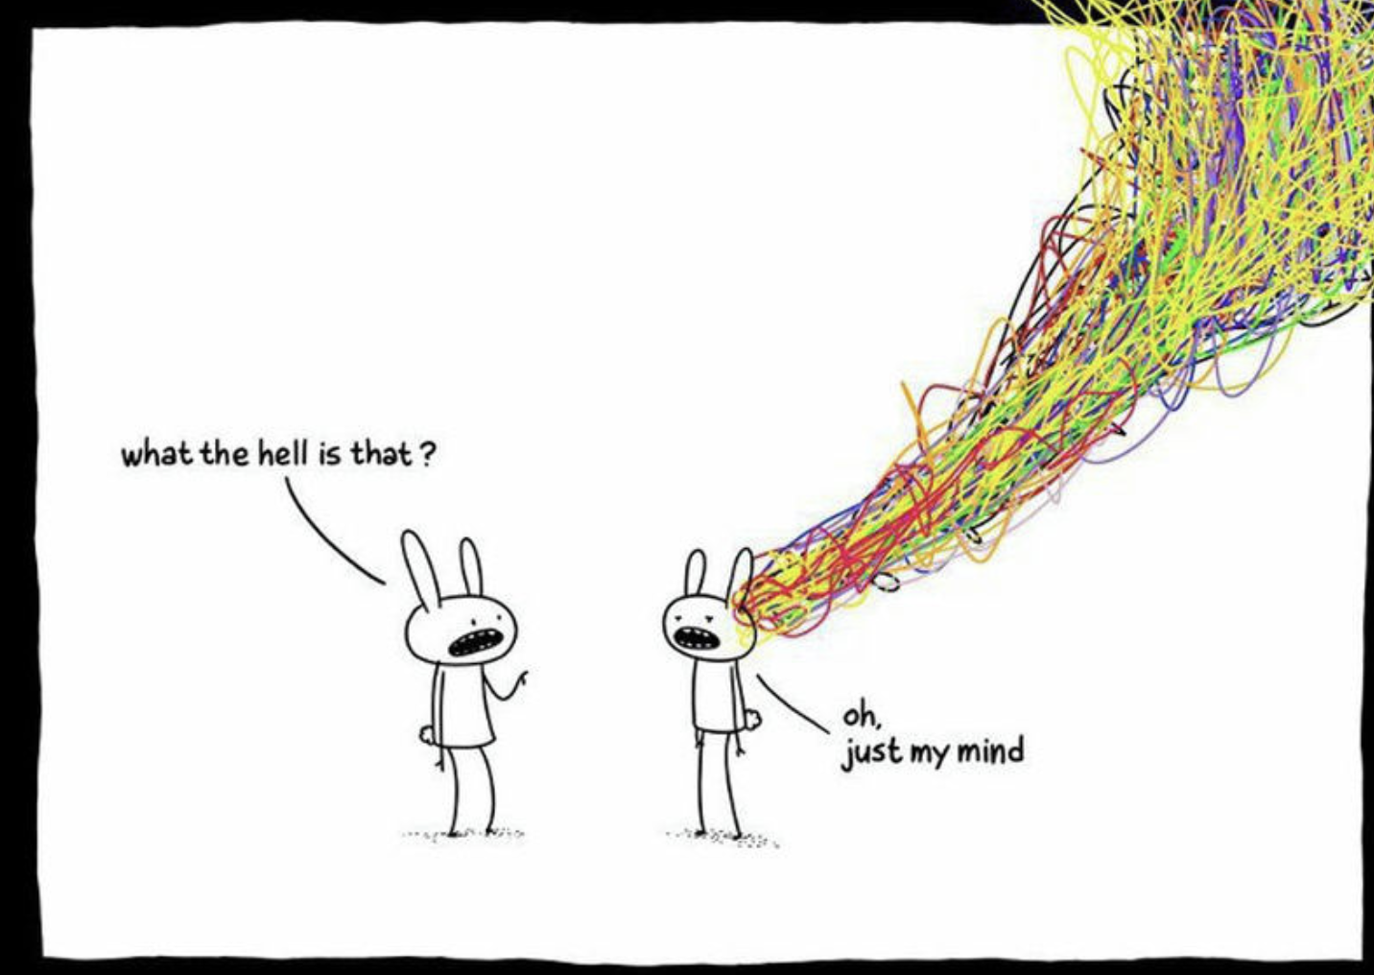
Google images -http://www.stephengthomas.com/

Slide 5
Guidance for writing your essay
You must use the three journal articles that you have been provided
with (on the M51 canvas page) as well as choosing two of your own
journal articles
(think carefully about the quality of the articles you choose).
You will need to write 500 words critically analysing inclusive education,
making reference to all five journal articles.
Remember to reference correctly by referring to the APA referencing
guidelines which you will find on the M51 canvas page.
https://marjon.instructure.com/courses/2933/modules#module_28838

Slide 6
And finally….
….we are here to help !

Slide 7
Focused writing
This task requires your writing to be precise and focused.
Identify the key contrasting points from your reading that you wish to develop.
You do not need to write an introduction or conclusion.
Look at the five journal articles which consider inclusive education and ensure you provide different points of views to build criticality.

Slide 8
Getting started
Read M-level marking criteria available on Canvas and in your Handbook
AND BELOW!
Check you understand terminology used
Read task requirements
Read journal articles (accessed via links on Canvas)

Slide 10
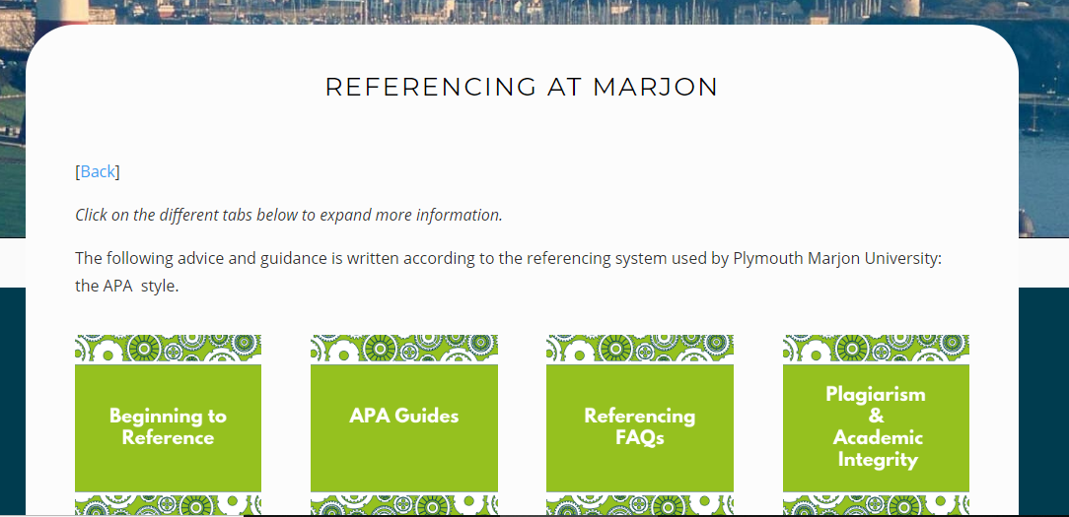
Referencing
We use the APA style of referencing, please look at the support pages if you are not familiar with this.
http://sites.marjon.ac.uk/handbook/referencing-scholarship

Slide 11
?

