Slide 1
Course title and date of event
BSc Sport Business Management
Open Day

Slide 2
Welcome. We will be covering…
Is this course for you?
Why study at Plymouth Marjon University?
Our course offer/teaching/assessment style
Accreditation/opportunities/outcomes
How teaching has worked this year/might work next year
What our students say about us
Life as a student and any questions

Slide 3
Marjon statistics slide 1

Slide 4
Marjon statistics slide 2

Slide 5
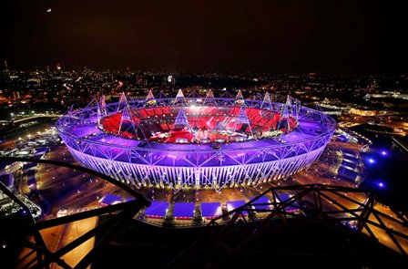
How will we teach you?
Delivered by specialist subject academics across the School of Sport Health and Wellbeing , the Business School, and sport and business industry practitioners.
Academic underpinning
Personalised support
Applied industry experience

Slide 6
Industry endorsement Double accreditation
Professional Occupational Standards
‘Entry Manager’ mapped to Years 1 & 2
‘General Manager’ mapped to Year 3
The CMI is the leading body in the UK for Leadership and Management.
You will receive CMI L5 Diploma in Management and Leadership. No extra cost to you and no additional assessment.

Slide 7
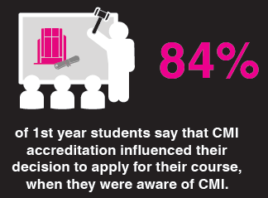

Slide 8
The sports landscape
National SO
Regional SO
Community Sport Organisations
International SO
Public Sector
Voluntary/not-for-profit
Commercial
sector

Slide 9
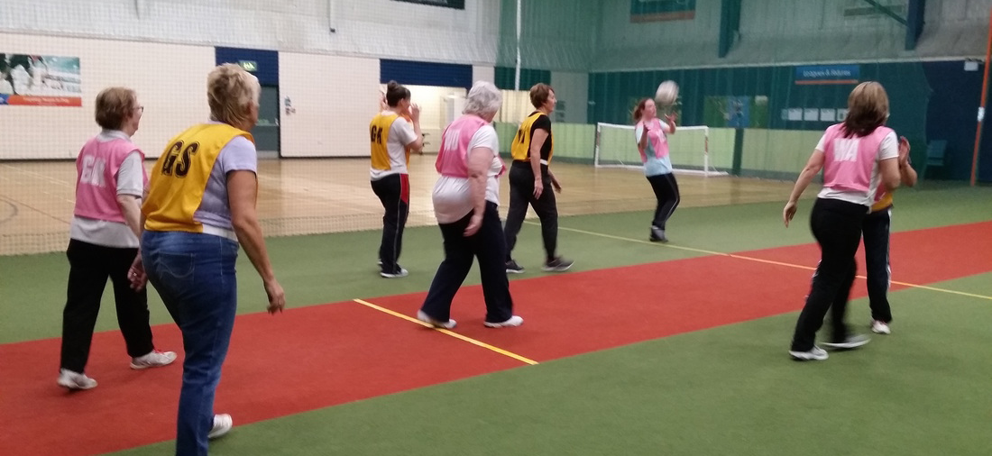
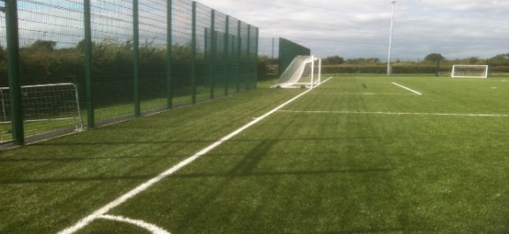
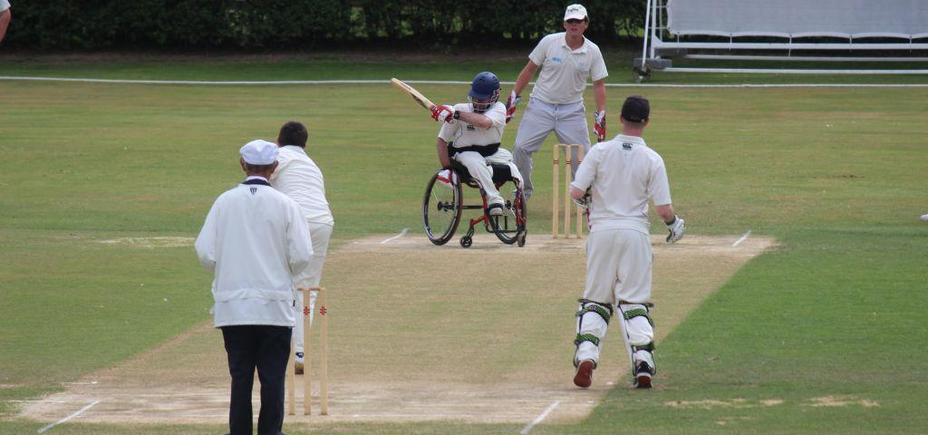
Using sports power for other benefits!
Societal
Developing people, facilities, organisations
Opportunities for all – customer service and soft skills

Slide 10
An exciting and dynamic industry that requires knowledge and appreciation of:
Sport
Leadership
Marketing
Management
Event Management
Human Resources
Finance
Customer Service
Strategy
Entrepreneurship

Slide 11
Camp America?
OPPORTUNITY TO SPEND 9 WEEKS LIVING AND WORKING ON A SUMMER CAMP IN THE USA!

Slide 12
Year-Long Industry placement / internship?
Local
National
International

Slide 13
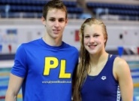
Employer Partnerships

Slide 14
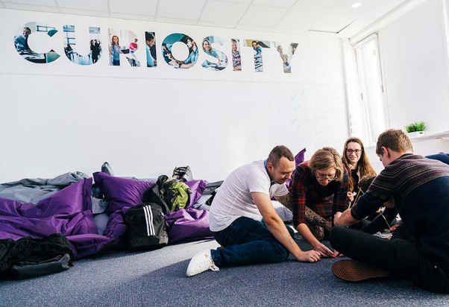
Assessment
Business Reports
Essays
Presentations
Pitches
Posters
Business Plans
Reflective Portfolios
Multi-choice in-class tests
Event Management delivery and evaluation

Slide 15
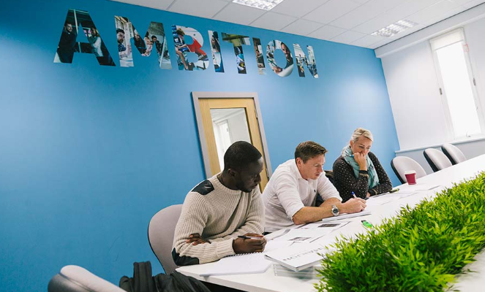
Facilities
Enterprise and Employability
Hub – The Edge
Extracurricular Activities
Business Support and Guidance
Incubation Space
Enterprise Ambassadors
Futures

Slide 16
A great university community
Online
Face to face

Slide 17
Plymouth – A Great Place to Study!

Slide 18
Career routes SBM
Careers
International
Sport
Dev.
NGB’s
Post grad study
Public Sector agencies
Sport Man.
Facility Man.
Event Man.
Marketing & comms.
Prof Sports
Third sector SM

Slide 20
Keep in touch…
Name Dr Phil Brown
Senior Lecturer and Programme Leader
Course name BSc Sport Business Management
Plymouth Marjon University
pbrown@marjon.ac.uk
Happy to have an informal chat over the phone
@MarjonSPDEV

