Slide 1
Course title and date of event
FD and BA Sport Development and Coaching
Open Day

Slide 2
Welcome. We will be covering…
Is this course for you?
Why study at Plymouth Marjon University?
Our course offer/teaching/assessment style
Accreditation/opportunities/outcomes
How teaching has worked this year/might work next year
What our students say about us
Life as a student and any questions

Slide 3
Marjon statistics slide 1

Slide 4
Marjon statistics slide 2

Slide 5
National Student Survey – full marks for student satisfaction!
Satisfaction in the National Student Survey 2020, including:
Staff are good at explaining things: 100%
My course has provided me with opportunities to apply what I have learnt: 100%

Slide 6
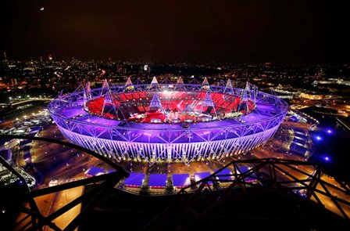
How will we teach you?
Delivered by specialist subject academics across the School of Sport Health and Wellbeing and sport industry practitioners.
Academic underpinning
Personalised support
Applied industry experience

Slide 7
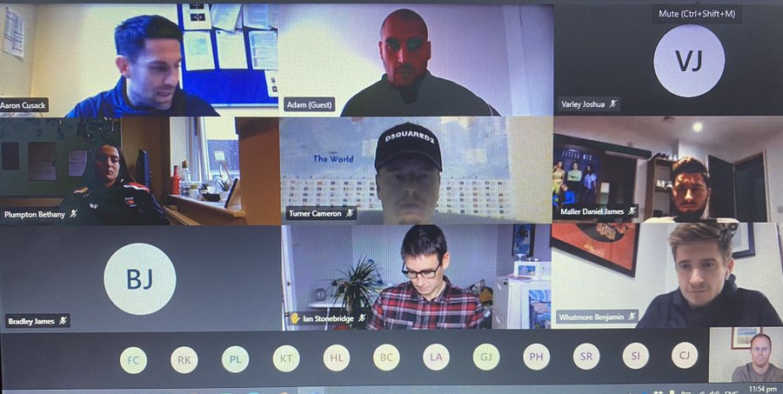
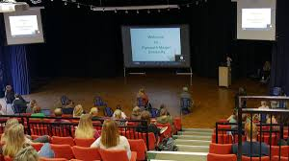
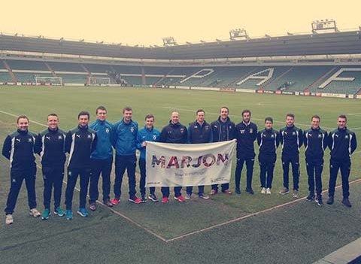
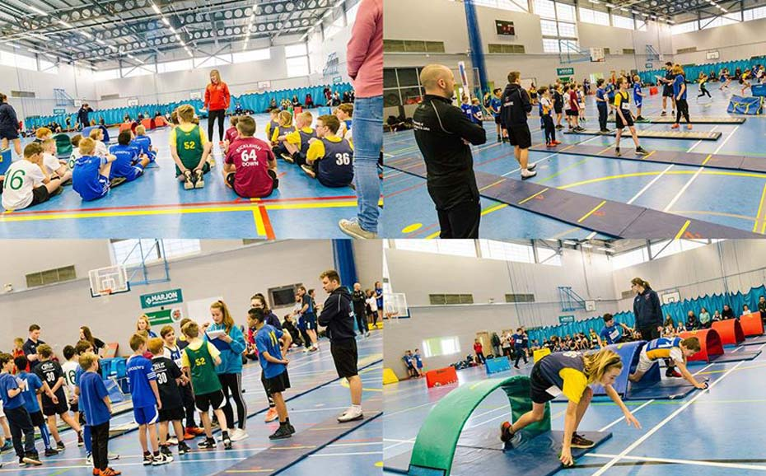
How will we teach you?

Slide 8
Structure of programmes
3 years BA Hons.
2 Years FD + 1 option for BA
6 modules per year (or equivalent)
Core modules and optional modules within specialist modules
‘Personalise’ your learning. We expect growing independence as you progress

Slide 9
An exciting and dynamic industry that requires knowledge and appreciation of:
Coaching
Education
Pathways: grassroots to elite
Management
Wider society
Inclusion
Event Management
Programme Management
Policy to practice

Slide 10
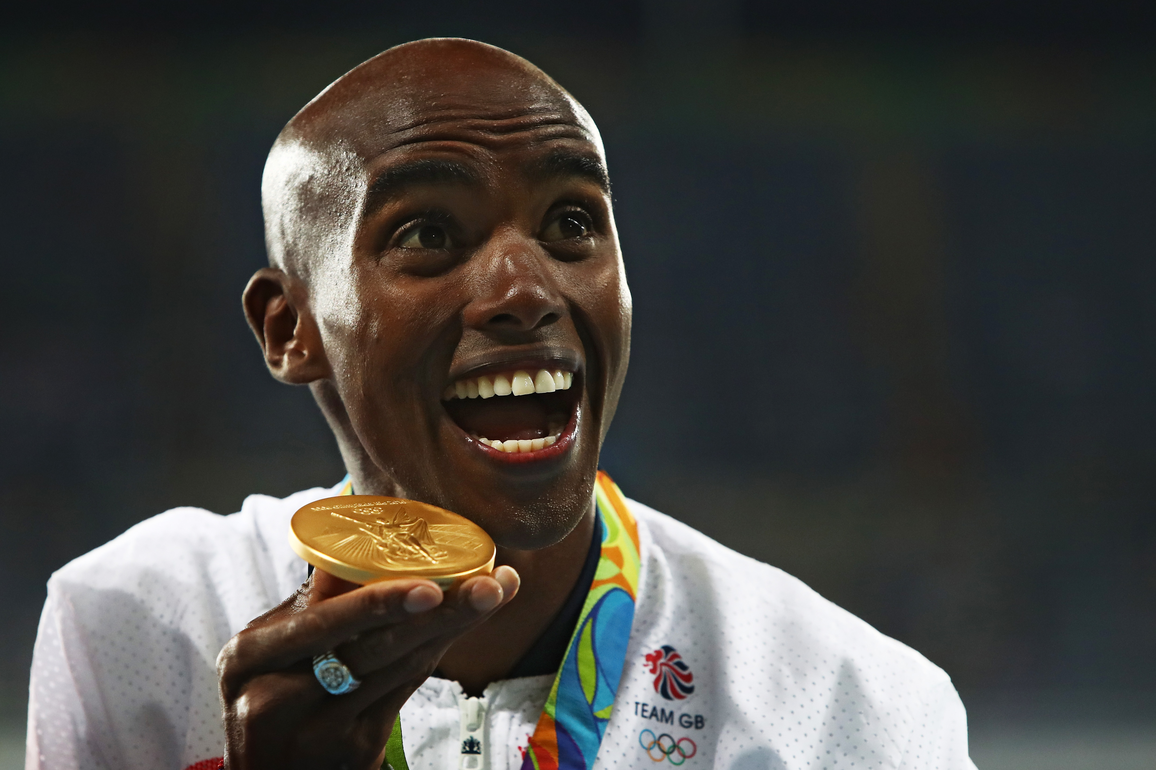
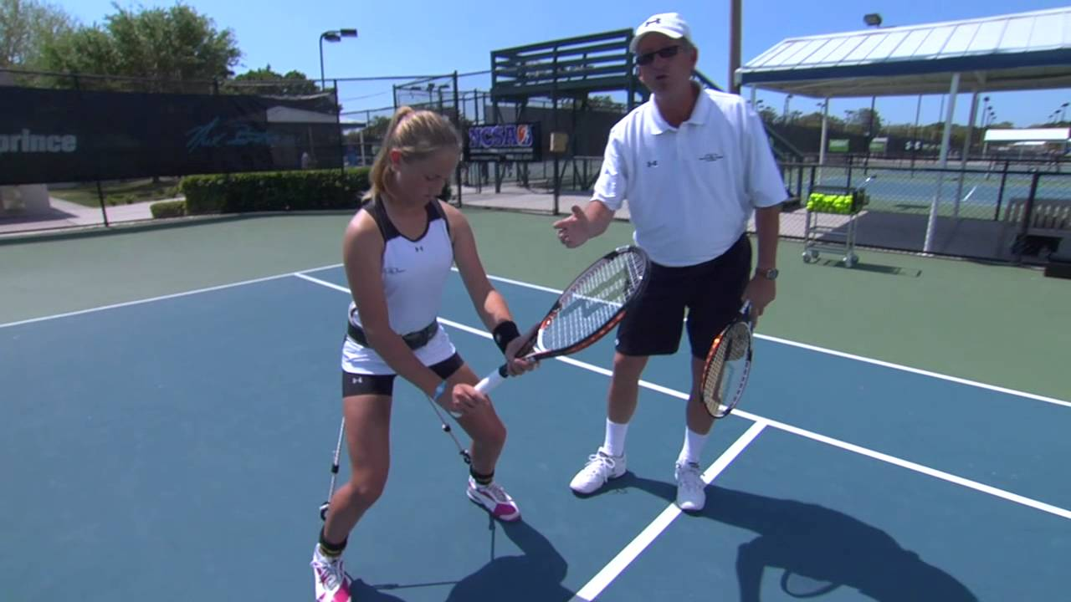
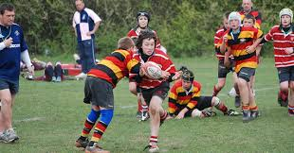
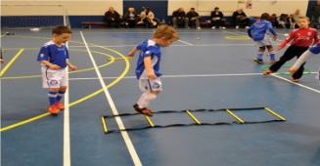
What is sport development? Developing individuals: From entry to excellence
Excellence
PLAYER PATHWAY
Performance
Participation
Foundation

Slide 11
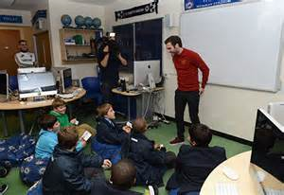
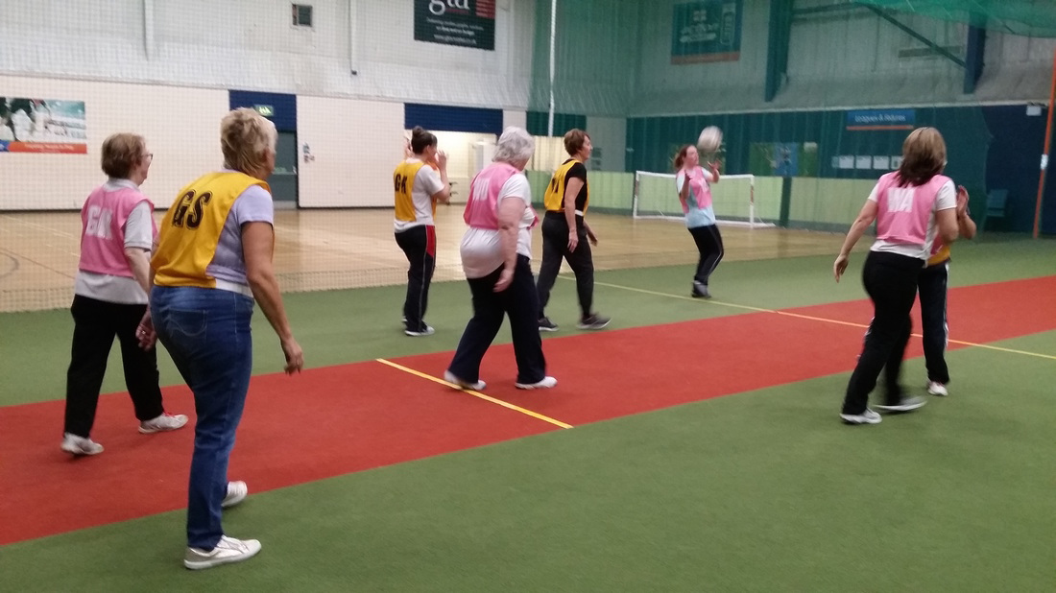
Or…..using sport’s power for wider societal good

Slide 12
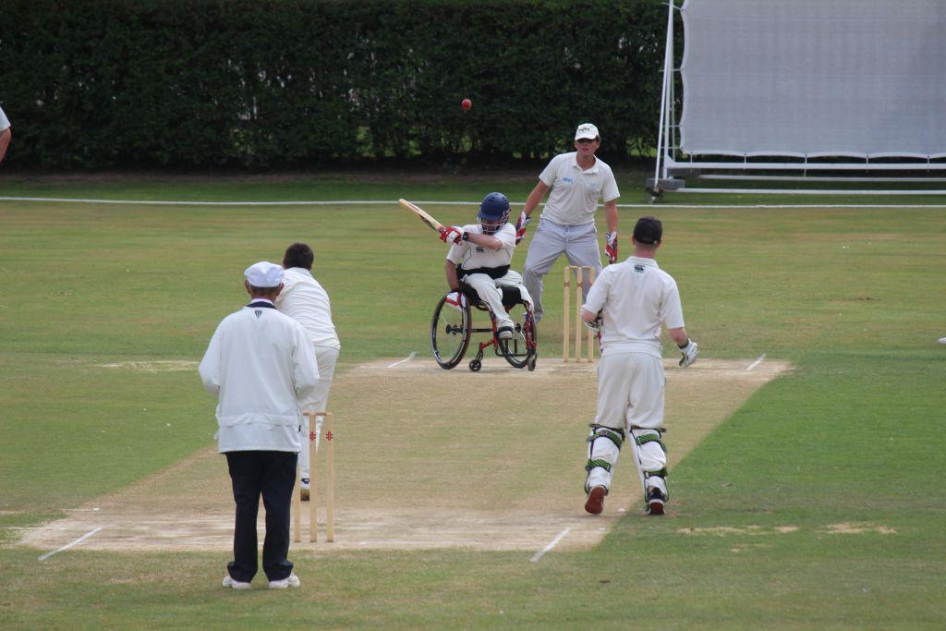
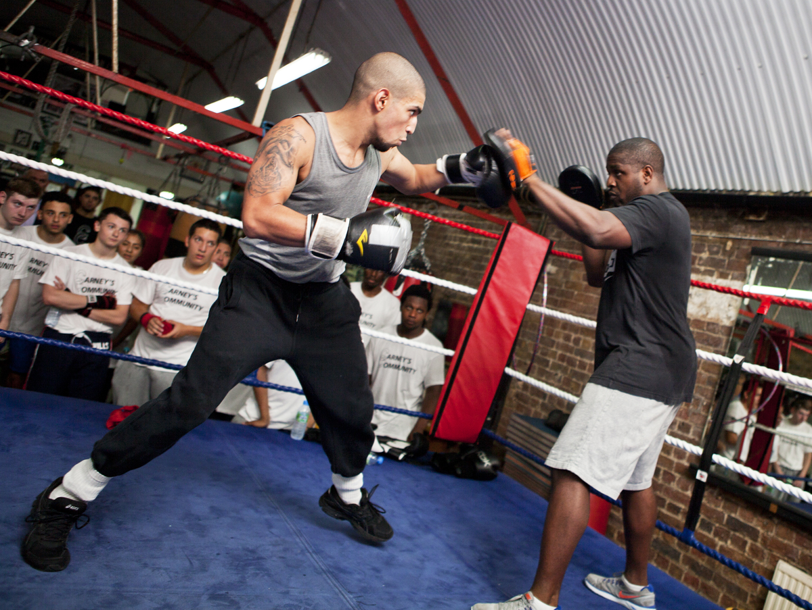
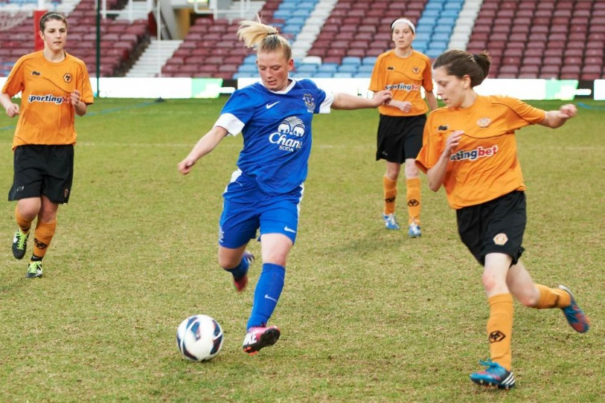
At the heart of this type of work: Providing opportunities for all

Slide 13
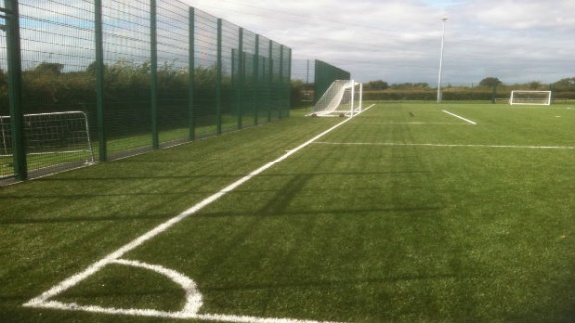
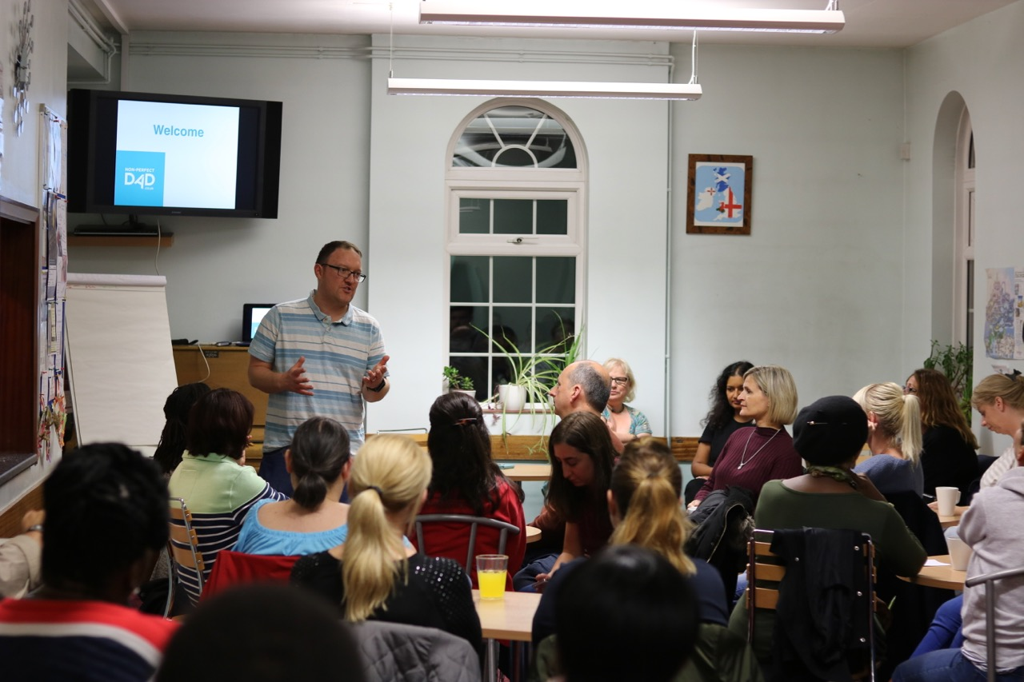
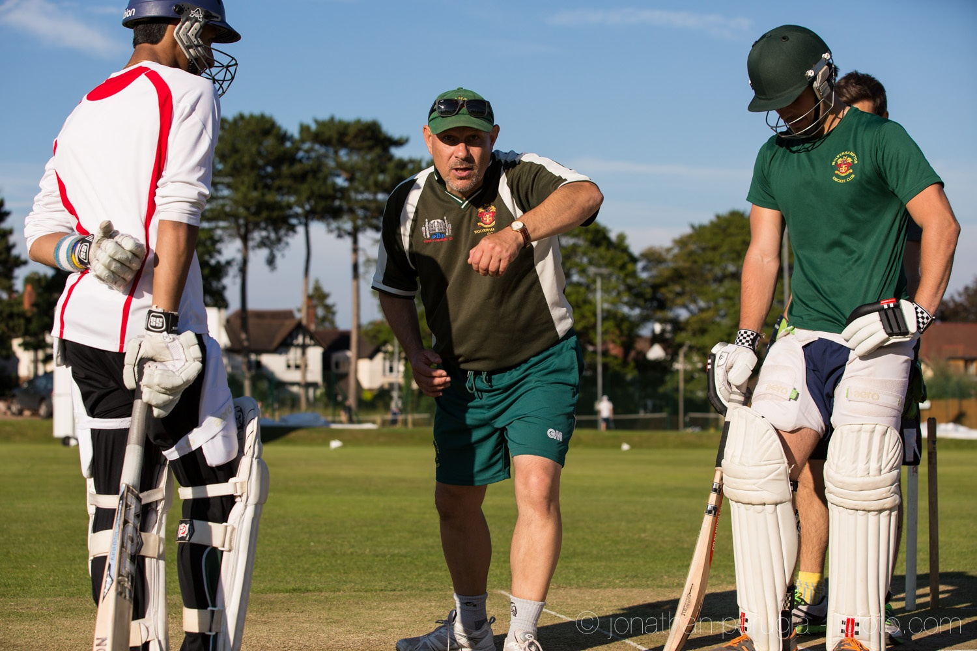
Development of opportunities for: People, Facilities, Organisations…….

Slide 14
Good coaching is central to this
Engage and connect with participants
Powerful role model and advocate for sport/activity
Can aid in driving participation
Develop talent
Broker for connections between a range of stakeholders

Slide 15
Employer Partnerships

Slide 16
Degree Accreditation: Extra Qualifications / Awards: SPD
Professional Occupational Standards
Assistant Coach mapped to Years 1 & 2
Coach mapped to Year 3
Working with Schools (extra curriculum)

Slide 17
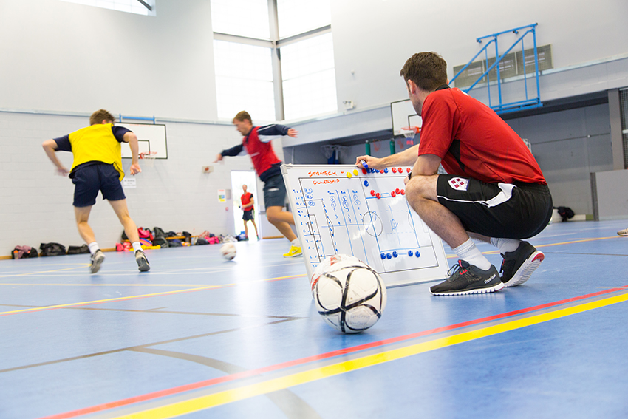
Career routes
Careers
Coaching internationally
Sport Management
Prof Football Clubs
Pro Club Comm. Depts.
Sport/
Football Dev. Officer
NGB’s
Masters Degree
Teaching
Football Academies
Postgraduate Research / Lecturer
County Sports Partnership
Soccer Schools

Slide 18
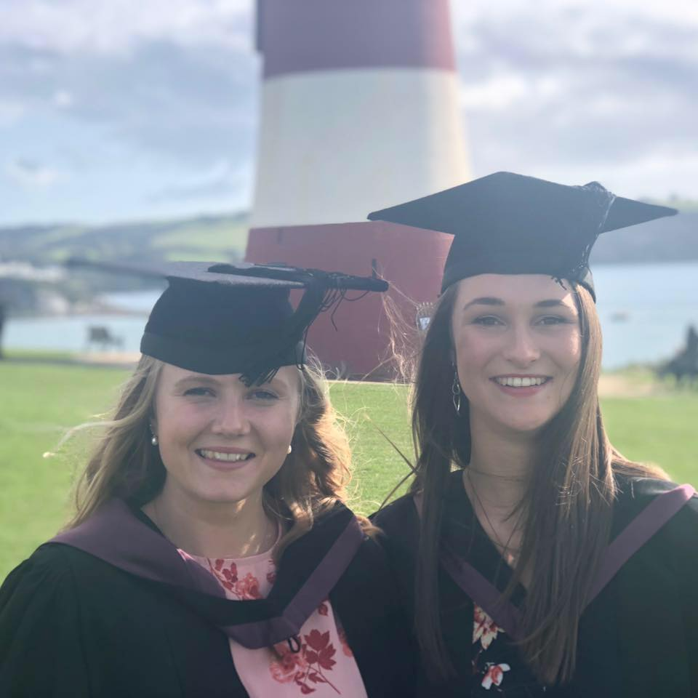
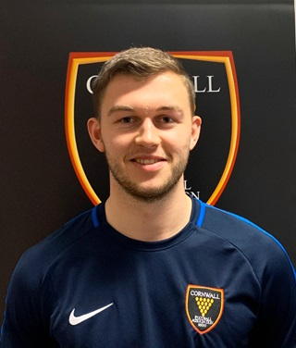
Recent success stories… see @MarjonSPDEV

Slide 19
Why come to Marjon?
Good reputation
Good access to city, sea and moor
Friendly caring staff
Small single campus
Many sporting opportunities including our new state of the art sports facilities
Supportive relationships
Treated as an individual
Online and in person support
Great industry connections

Slide 21
Keep in touch…
@MarjonSPDEV
Dr Phil Brown
Lecturer and Programme Leader
FdA/BA Sport Development and Coaching
Plymouth Marjon University
pbrown@marjon.ac.uk
Happy to have an informal chat over the phone
Ryan Thomas (Senior Lecturer) Call: 01752 636700 (ext.5642) Email: rthomas@marjon.ac.uk

